Slide 1
Advanced Controls

Slide 2
Computer Vision
Solving for Angles and Distances
X-Axis Alignment
Distance
Solutions
Computer Vision (SolvePNP)
Coprocessor
Roborio
Raspberry Pi (Preferred)
https://www.chiefdelphi.com/uploads/default/original/3X/5/e/5e2fb8ce56e27d7f4f63a97731700e4684d550e4.pdf
Limelight
Raspberry Pi
Software

Slide 3
Limelight
Uses Network Tables
NetworkTable table = NetworkTable.getTable("limelight");
double tx = table.getNumber("tx", 0); // Angle Offset from Target
double ty = table.getNumber("ty", 0);
X Angle Offset Given
Solve for Distance
Given
Height from Ground
Angle from Ground
Find
Distance using Trig
https://docs.limelightvision.io/en/latest/getting_started.html#basic-programming

Slide 4
Control System
Analyzing and Predicting Behavior of Systems
Heater
Fan Speed
Application within FRC
Predicting motor behavior
Accounting for unexpected behavior
Too much Voltage
Feedback Controller
Applies Ideas Above
Predicts and Accounts for unexpected behavior

Slide 5
PID Controller
PID
Proportional
Error to 0
Integral
Area of curve between setpoint and output
Derivative
Slope to 0
PID Controller
Kp * Error + Ki * Integral of Error + Kd * Derivative of Error

Slide 6
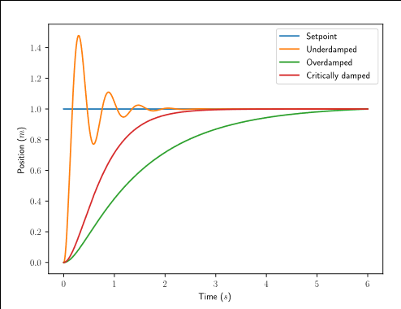
Tuning a PID Controller

Slide 7
Tuning a PID Controller
Set Kp, Ki, Kd to 0
Increase Kp until oscillate around Setpoint
Increase Kd without jittering
Increase Ki if settling above or below setpoint
Feedforward is preferred
Feedforward
kF * Setpoint

Slide 8
PID Controller
WPILib
PIDController pid = new PIDController(kP, kI, kD);
motor.set(pid.calculate(encoder.getDistance(), setpoint));
pid.setTolerance(5, 10);
pid.atSetpoint();

Slide 9
Feed Forward
SimpleMotorFeedforward feedforward = new SimpleMotorFeedforward(kS, kV, kA);
https://docs.wpilib.org/en/stable/docs/software/advanced-control/controllers/feedforward.html
motor.setVoltage(pid.calculate(encoder.getDistance(), setpoint) + feedforward);

Slide 10
Trajectory Generation
Interesting Improvement
Generate Trajectory
Autonomous
“Draw” routes”
Outline
PID with Feedforward
Drivetrain Subsystem
Create Trajectory (TrajectoryGenerator)
RamseteController
Docs
https://docs.wpilib.org/en/stable/docs/software/advanced-control/trajectories/index.html
Tutorial
https://docs.wpilib.org/en/stable/docs/software/examples-tutorials/trajectory-tutorial/index.html

